Slide 1
TE 262: Electromagnetic Fields Examiner: M. S. Ellis, PhD smellis.coe@knust.edu.gh 057 904 7591

Slide 2
Syllabus
Introduction to electromagnetics: circuit theory, concept of electromagnetic theory, electromagnetic field quantities, universal EM constants and SI units
Vector Analysis and Orthogonal Coordinate systems : Gradient, divergence, curl, divergence theorem, stokes theorem, null identities, Helmholtz’s theorem
Electrostatics: Postulates of Electrostatics, Solutions of electrostatics boundary value problems (Poisson, Laplace equations), Scalar electric potential, Dielectric material
Magnetostatics: Postulates of Electrostatics, Magnetostatics boundary conditions, magnetic vector potential, Poissons equation, magnetic materials
Electromagnetism: Electric fields, conductors, insulators, capacitance, magnetic field in free space, magnetic effects on iron.
Maxwell’s equation: Differential and integral forms
EM Waves theory: EM waves in a homogeneous medium, uniform plane waves, skin effect, Poynting vector

Slide 3
Reference material
Cheng, David, K, Fundamentals of Engineering Electromagnetics, Addison-Wesley, 1993
Hayt, W. H. and Buck, J.A., Engineering Electromagnetics, 7th Edition, New York, McGraw-Hill, 2004
Yi Huang and Kevin Boyle, Antenna from theory to practice, John Wiley, 2008

Slide 4
1. The Electromagnetic Model Overview of electromagnetics
Electromagnetics is the study of the electric and magnetic phenomena caused by electric charges at rest or in motion
Existence of electric charges was discovered by Greek astronomer and philosopher Thales of Miletus
He noticed that an amber rod, after being rubbed with silk or wool attracted small bits of paper
The word electron was derived from the Greek word for amber which is elektron, from which electronics, electricity…etc stems from

Slide 5
An electric field has two sources: a positive charge and a negative charge
Moving electric charges produce current which gives rise to a magnetic field
A field is a spatial distribution of a quantity which may or may not be a function of time
Therefore a time-varying electric field is accompanied by a magnetic field, and vice versa
A time-varying electric field coupled with a time-varying magnetic field results in a electromagnetic field

Slide 6
Why is the concept of electromagnetics essential ?
The concept of fields and waves are essential in the explanation of actions at a distance
For example, how does an object fall toward the earth surface if there are no elastic strings connecting a free-falling object and the earth ??
This can be explained by the existence of a gravitational field
Similarly, the possibilities of satellite communication can be explained only by postulating the existence of electric and magnetic fields

Slide 7
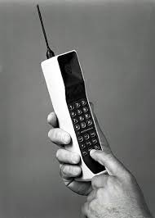
A mobile phone on transmit sends a message-carrying current at a certain frequency from the source to the antenna ends
From circuit-theory point of view, the end of the antenna is connected to an open space (open circuit). Hence no current will flow
How is mobile communication possible then ??
Electromagnetic concepts must be used to explain this phenomenon, since circuit-theory is limited in this regard

Slide 8
Three essential steps are involved in building a theory or model
Step 1: Define some basic quantities relevant to the subject of study
Step 2: Specify the rules of operation (mathematics) of these quantities
Step 3: Postulate some fundamental relations or Laws
For instance in Circuit theory (Circuit model):
Step 1 involves defining basic quantities like resistors, capacitors, inductors, voltages and currents
Step 2 involves defining algebraic rules, differential equations, and Laplace transformations.
Step 3 involves creating laws like Kirchhoff's voltage and current laws

Slide 9
Similarly, in electromagnetic model:
Step 1 will be defining the basic quantities of electromagnetics
Step 2 will be defining the rules of operation. This includes vector algebra and vector calculus
Step 3 will be presenting the fundamental postulates/laws of electromagnetics

Slide 10
Quantities of an EM model can be divided into source and field quantities
Source is electric charges at rest or in motion
Electric charge is the fundamental property of matter and exists in positive or negative integrals of the charge of an electron, e
e = 1.60 x 10 ⁻¹⁹ Coulomb (C)
“Electric charge can neither be created nor destroyed but can be redistributed from one place to another” – principle of conservation of electric charge.
It must be satisfied at all times and under all conditions

Slide 11
Source quantities are:
Volume charge density, surface charge density, and line charge density
ρ_{v=} lim ∆q/∆v (C/m³) Volume charge density
_{∆v → 0}
ρ_{s=} lim ∆q/∆s (C/m²) Surface charge density
_{∆s → 0}
ρ_{l=} lim ∆q/∆l (C/m) Line charge density
_{∆l → 0}
Charge densities are point functions because they vary from point to point
Current is the rate of change of charge with respect to time, that is
I = dq/dt (C/s or A)
Current must flow through a fine area, hence it is NOT a point function

Slide 12
There are 4 fundamental vector field quantities in electromagnetics:
Electric field intensity E, electric flux density D, magnetic flux density B, and magnetic field intensity H
Electric field intensity E, is the only vector needed in discussing electrostatics in free space
Electric flux density (Electric displacement) D, is useful in the study of electric field in a material (medium)
Magnetic flux density B, is the only vector used in discussing magneto-statics (steady electric currents) in free space
Magnetic field Intensity H, is useful in the study of magnetic field in material media

Slide 13
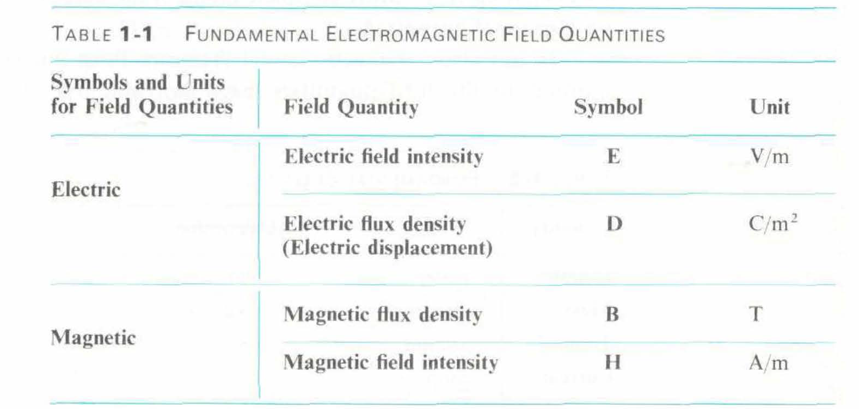
In static, steady or stationary cases (when there is no time variation), the E field quantities E and D and magnetic quantities B and H form two separate vector pairs
In time-dependent cases, electric and magnetic field quantities are coupled. Meaning, a time varying E and D will create B and H, and vice versa

Slide 14
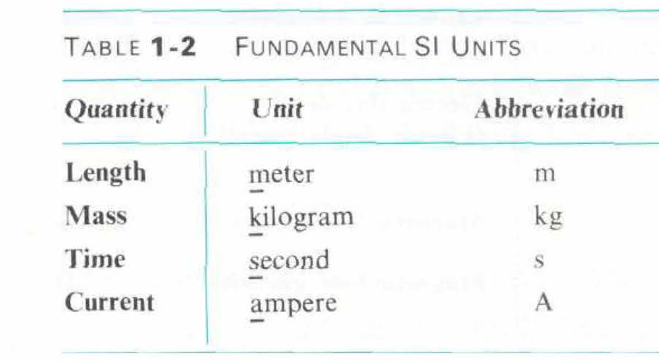
SI units
In electromagnetics, four main SI units are used:
The units in Table 1-1 are derived units that can be expressed in terms of the fundamentals unit; meters, kilograms, seconds, and amperes.

Slide 15
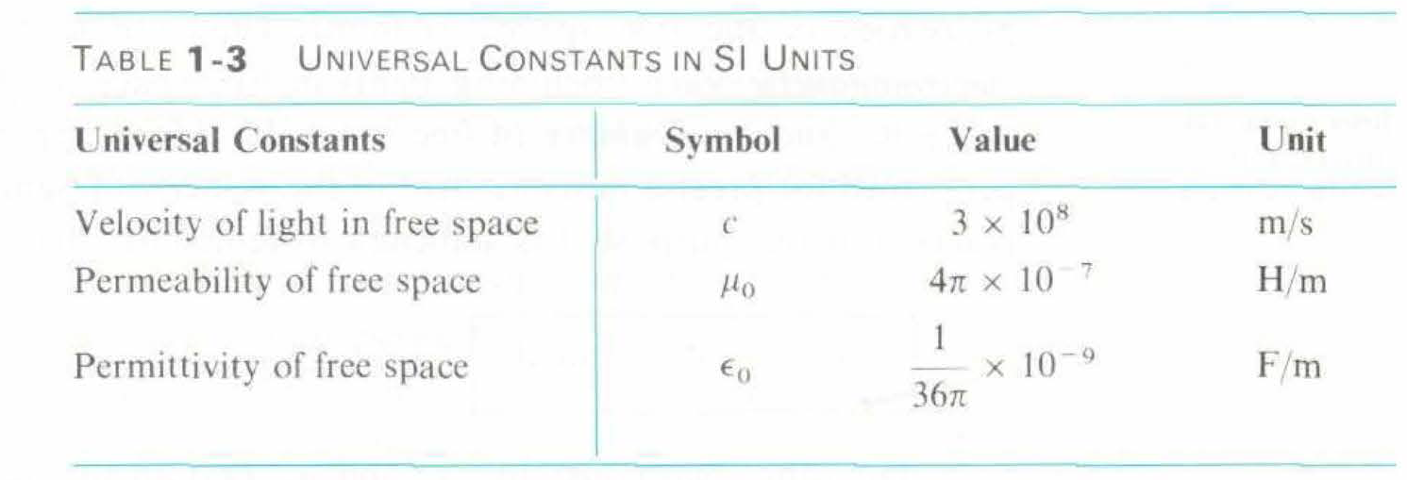
Universal constants
In the electromagnetic model, there are 3 universal constants in addition to the field quantities, and SI units
They relate to properties of free space (vacuum)
These constants are: speed of an EM wave c, permittivity of free space ɛ0, and permeability of free space µ0

Slide 16
2. VECTOR ANALYSIS
Step 2 of creating the EM model was defining the rules of operation
Many electromagnetic quantities are vectors so we must be able to handle them with ease
Either by addition, subtraction or multiplication
Certain differential operators and theorems are required to properly handle EM vectors: gradient, divergence and curl operators as well as Stokes’ theorems
In order to express results in a 3-Dimensional space, a suitable coordinate system must be chosen
Here, the three most common orthogonal coordinate systems will be used: Cartesian, Cylindrical, and Spherical coordinate systems

Slide 17
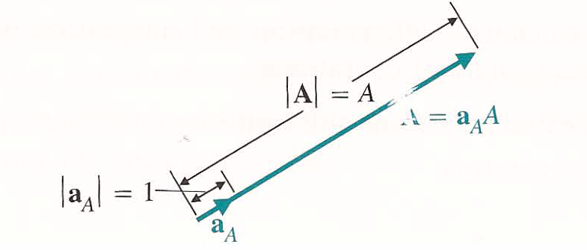
Vector addition and subtraction
A vector has magnitude and direction. A vector A can be written as A = aA A
Where A = |A| which is a scalar
aA = A / |A| is the unit vector having a magnitude of unity and dimensionless .

Slide 18
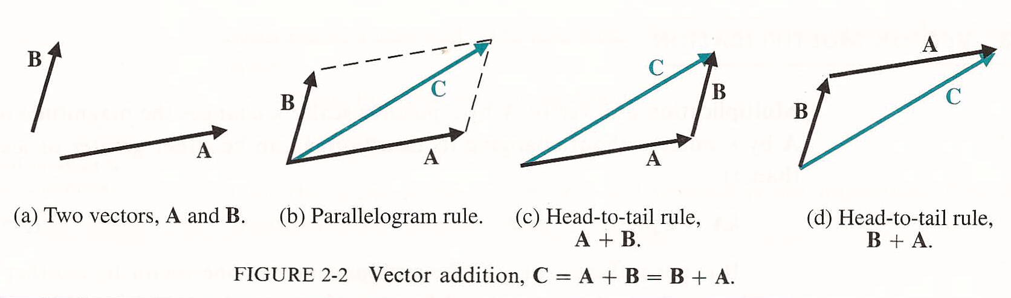
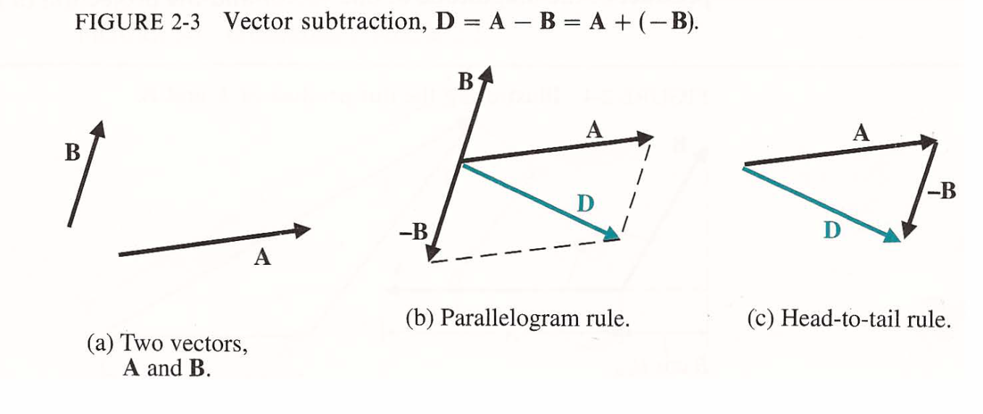
Vector addition and subtraction can be done in two ways: Parallelogram rule and head-to-tail

Slide 19
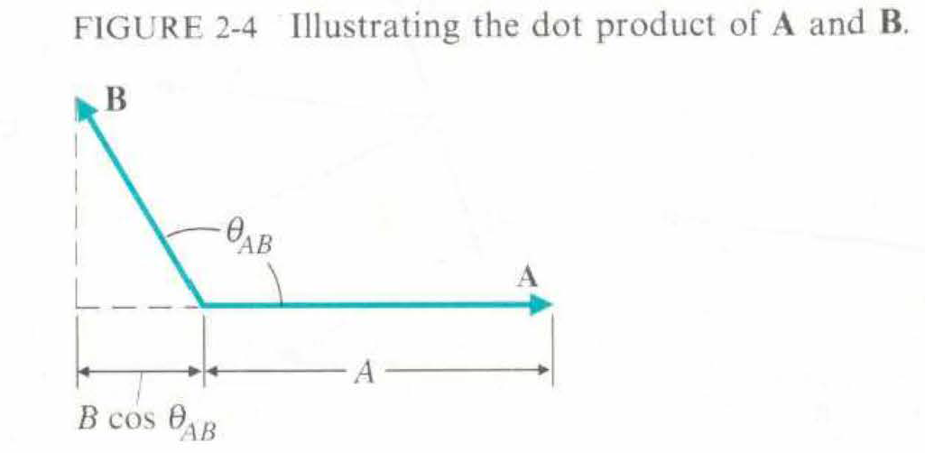
Vector multiplication
There are two ways of multiplying a vector: Scalar (dot) product and Vector (cross) product
Scalar or dot product
A . B = ABcosƟAB where A and B are the magnitudes of vectors A and B and ƟAB is the smaller angle between A and B and is less than 180 degrees
Dot product is commutative A.B = B.A
A.A = A² or A = √(A.A)

Slide 20
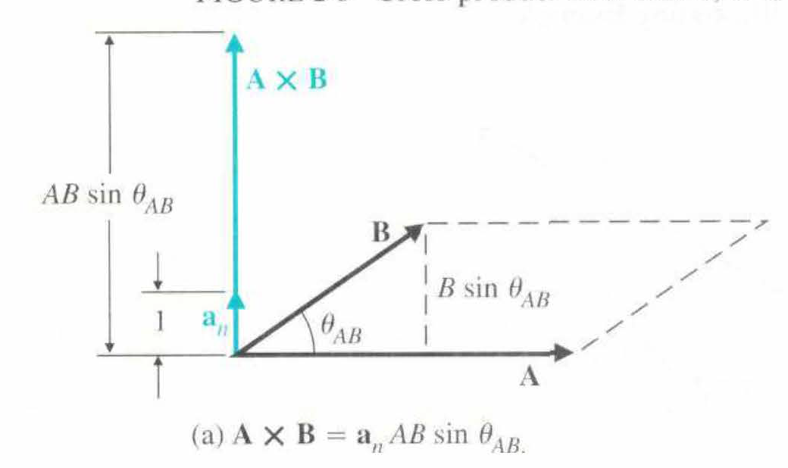
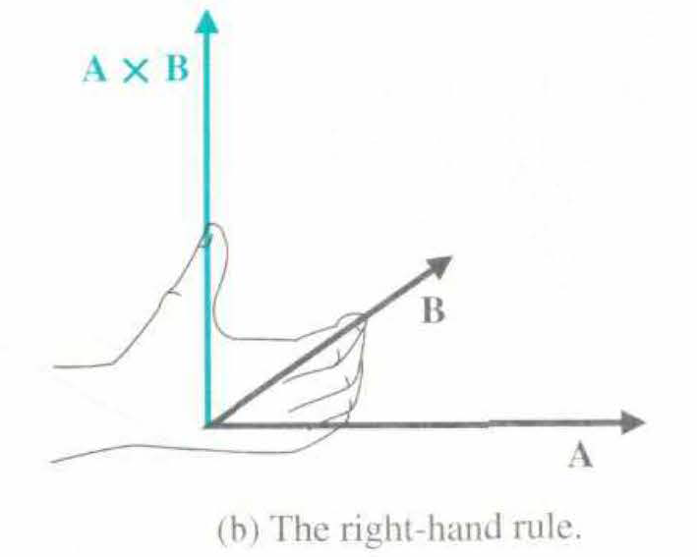
Vector or Cross product
A x B = anABsinƟAB where A and B are the magnitudes of vectors A and B and ƟAB is the smaller angle between A and B and is less than 180 degrees
an is a unit vector normal to the plane containing A and B
The direction of follows that of the thumb of the right hand when the fingers rotate from A to B through angle ƟAB
Dot product is not commutative
B x A = - A x B
The cross product of A x B results in another vector obtained by the right-hand rule and whose magnitude is equal to the area of a parallelogram

Slide 21
Orthogonal Coordinate Systems
Law of electromagnetics are invariant with coordinate systems. However solutions of practical problems requires that the law be expressed in a coordinate system that the problem is specified in
In a 3-Dimentional space, a point can be located as the intersection of three surfaces
These points may be either lengths or angles
When these three surfaces are mutually perpendicular to one another, we have an orthogonal coordinate system
Many orthogonal coordinate systems exist; most common ones are
Cartesian (rectangle) coordinates
Cylindrical coordinates
Spherical coordinates

Slide 22
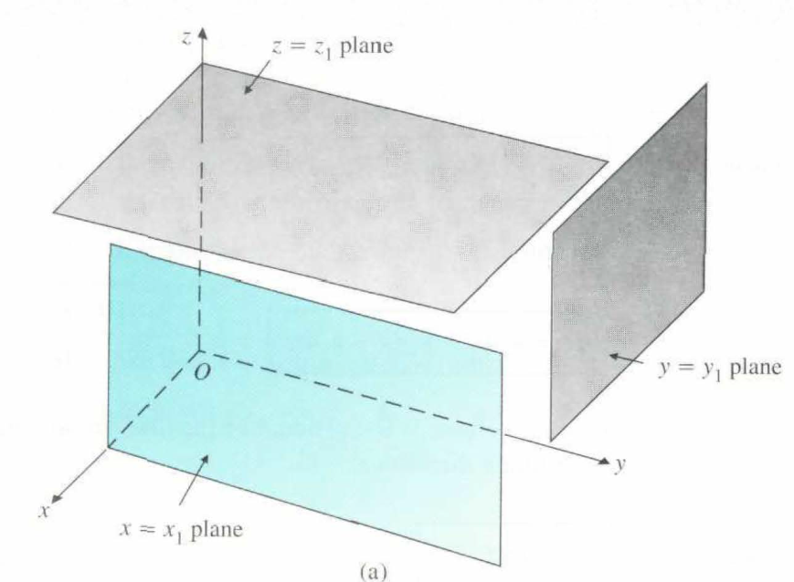
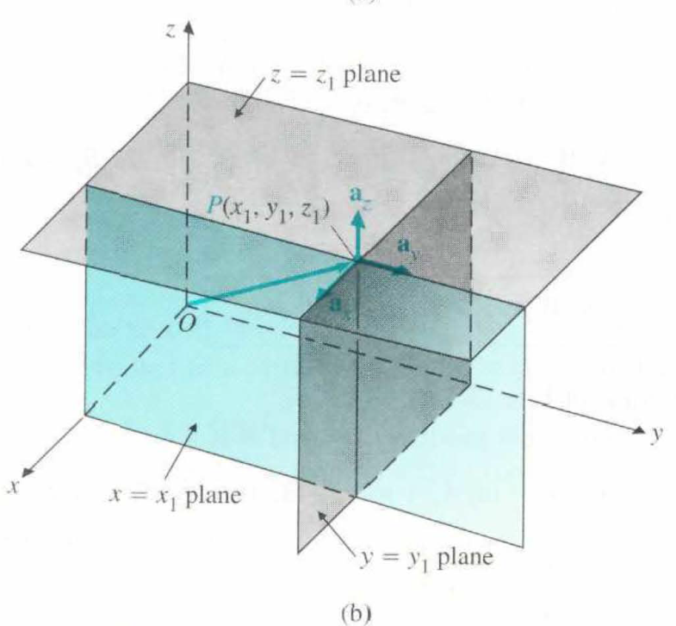
Cartesian Coordinates
A point P in Cartesian coordinates is represented by P (x, y, z)
The three mutually perpendicular unit vectors ax, ay, az are called base vectors
ax x ay = az ax . ay = 0 ax . ax = 1
ay x az = ax ay . az = 0 ay . ay = 1
az x ax = ay ax . az = 0 az . az = 1

Slide 23
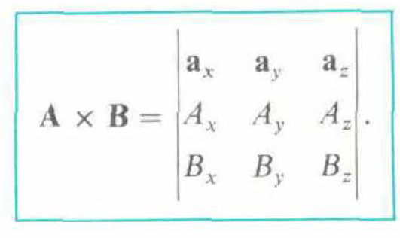
A = axAx + ayAy + azAz
dƖ= axdx + aydy + azdz
dv = dxdydz
A.B = AxBx + AyBy + AzBz
Vector A in Cartesian coordinates
Vector differential length in Cartesian coordinates
A differential volume in Cartesian coordinates
Scalar product of A and B in Cartesian coordinates
Vector product of A and B in Cartesian coordinates

Slide 24
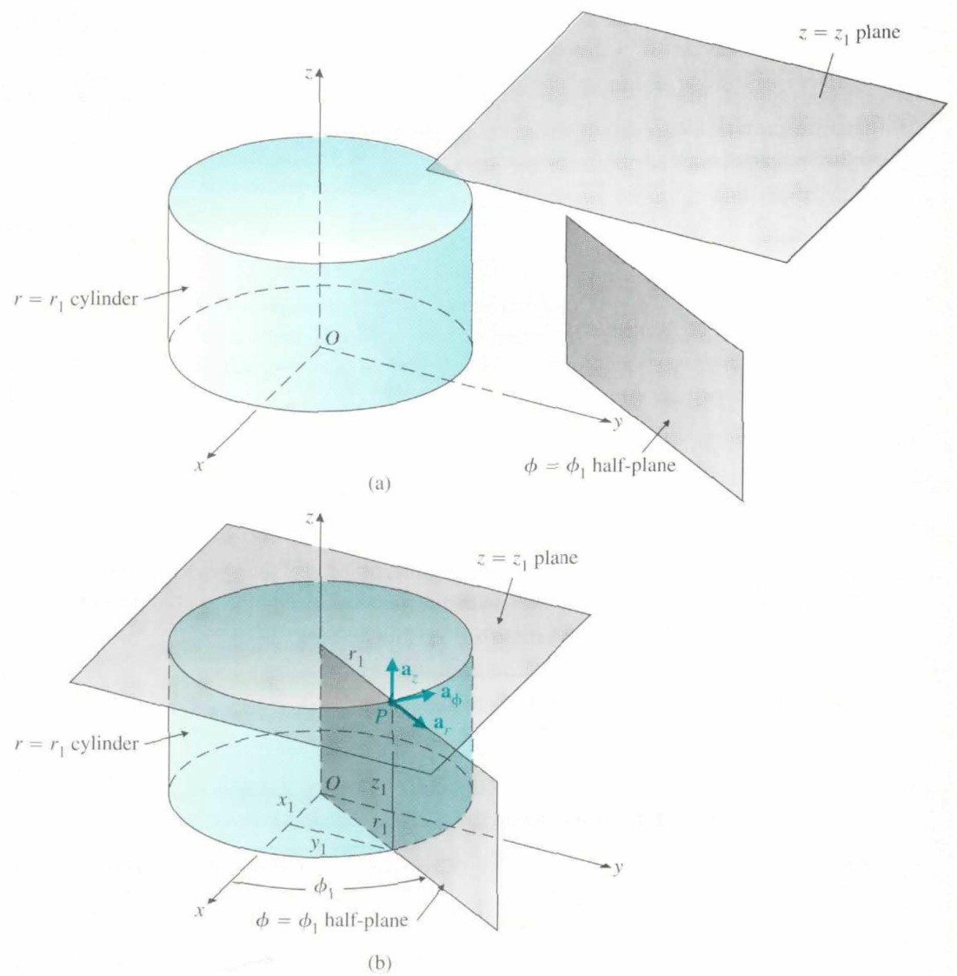
Cylindrical Coordinates
A point P in cylindrical coordinates is given by P ( r, ф, z)
ar x aф = az
aф x az = ar
az x ar = aф
dƖ = ardr + aфrdф + azdz → Vector differential length in cylindrical coordinates
dv = rdrdфdz → volume in cylindrical coordinates
A = arAr + aфAф + azAz → Vector A in cylindrical coordinates

Slide 25
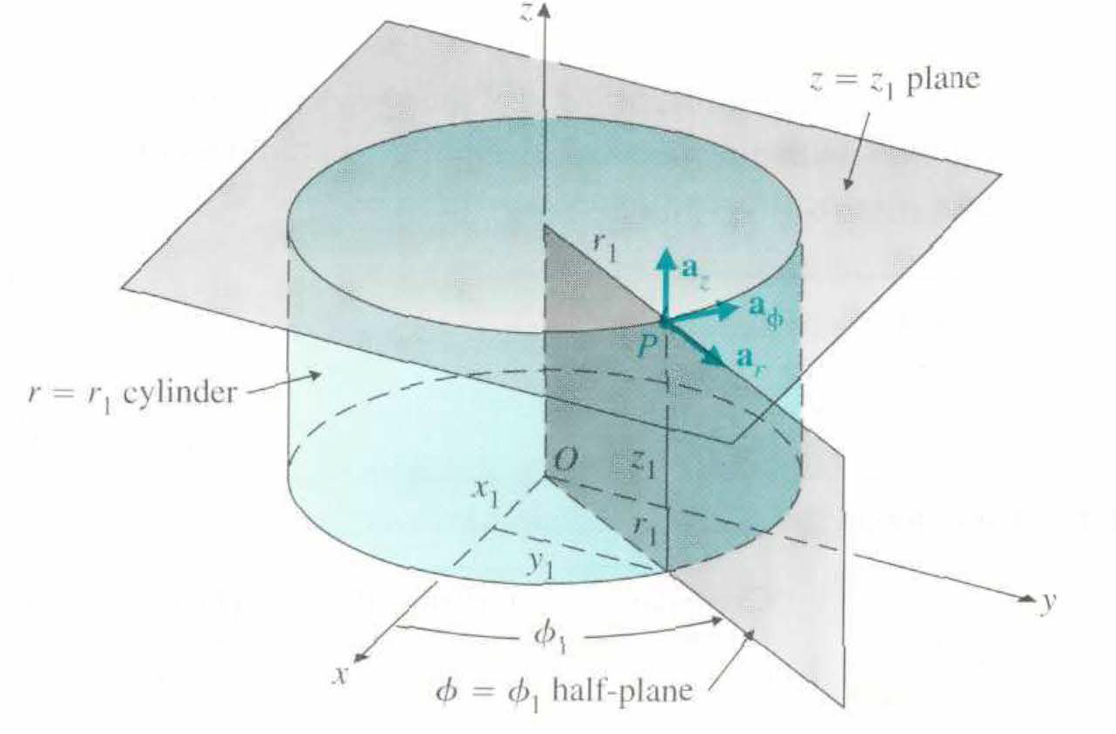
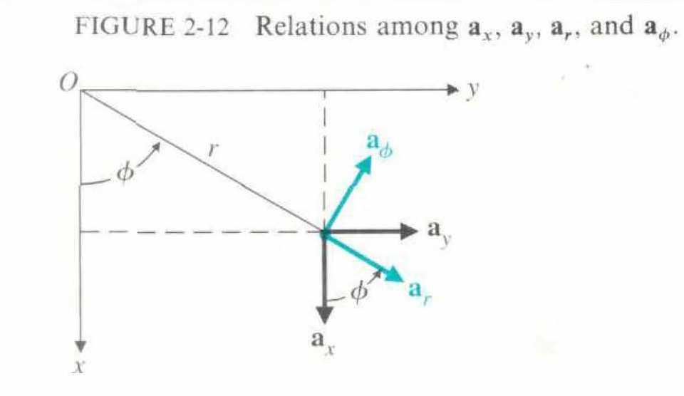
Transformation of the location of a point in cylindrical to Cartesian coordinates P(r,ф,z) to P(x,y,z):
x = r cos ф
y = r sin ф
z = z

Slide 26
Spherical Coordinates
A point P in cylindrical coordinates is given by P (R, Ɵ, ф)
aR x aƟ = aф
aƟ x aф = aR
aф x aR = aɵ
A = aRAR + aƟAƟ + aфAф Vector A in spherical coordinates
dƖ = aR dR + aƟ R dƟ + aф RsinƟ dф Vector differential length in spherical coordinates
dv = R²sinƟ dR dƟ dф A differential volume in spherical coordinates

Slide 27
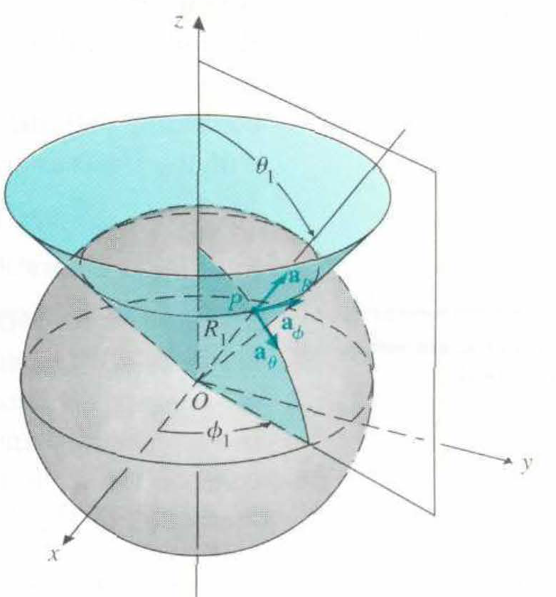
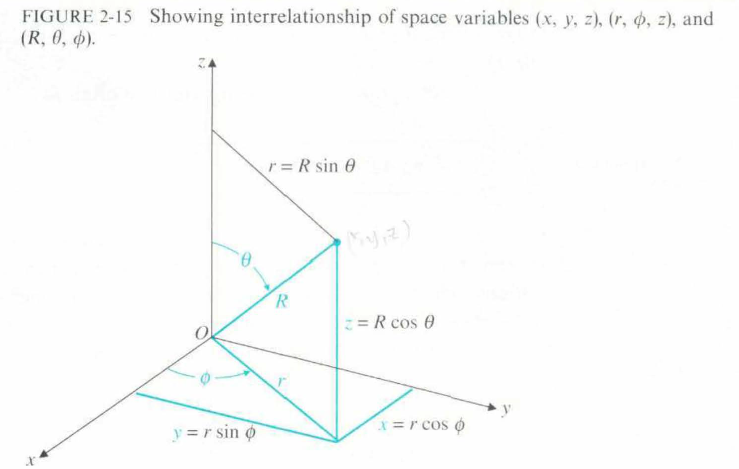
Transformation of a location of a point in spherical coordinates to Cartesian coordinates:
P(R, Ɵ, ф) to P(x, y, z)
X = R sinƟ cosф
Y = R sinƟ sinф
Z = R cosƟ

Slide 28
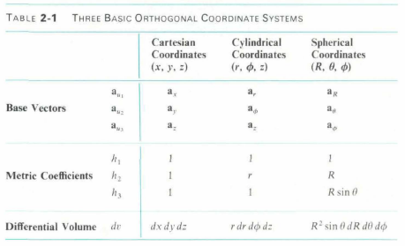

Slide 29
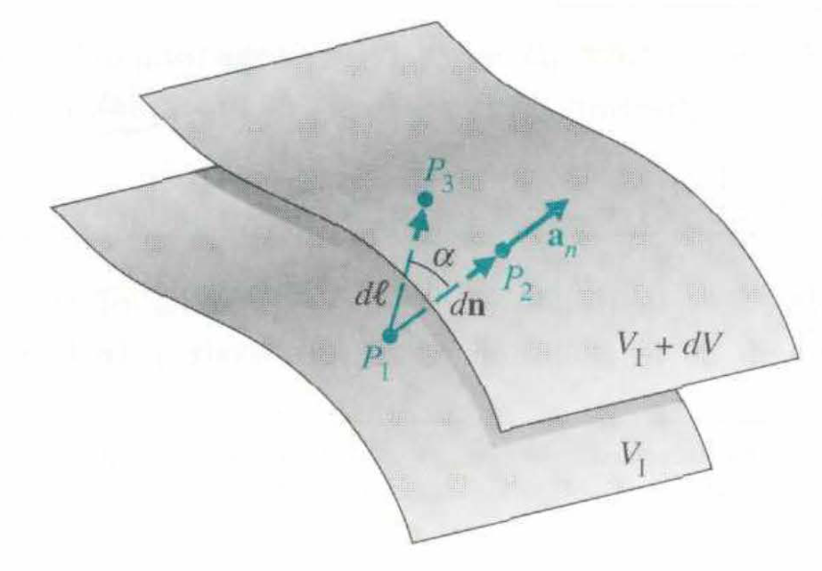
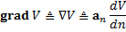
Gradient of a Scalar Field
Electromagnetic quantities often depend on both time and position
In general, fields may change as any of the variables in the coordinate system change
It is necessary to describe the space rate of change of a scalar field at any given time, t
Since the rate of change may be different in different directions, a vector is needed to define the space rate of change
Gradient is defined as the vector that represents both the magnitude and direction of the maximum space rate of increase of a scalar
Gradient is denoted by the symbol (nabla operator or del) which can be expressed as shown in Cartesian coordinates
In general orthogonal coordinates with coordinates (u1, u2, u3) and metric coefficients (h1, h2, h3), we can define gradient as :
Gradient of a scalar
Notes:
Explain why partial derivative. Explain why dV/dn over dV/dl, dl > dn …Gradient is the highest value (increase assuming dV is an increment), if it’s a decrease –dV/dl. Use students to determine directions of dn and dl

Slide 30
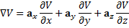
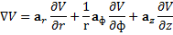
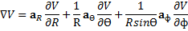
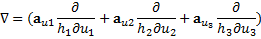
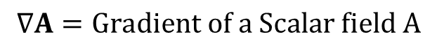
$$∇A=Gradient of a Scalar field A$$
(Cartesian)
(Cylindrical)
(Spherical)
(General)

Slide 31
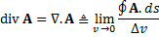
Divergence of a Vector Field
In studying vector fields, it’s convenient to represent field variations by directed field lines called flux lines
The flux lines are directed lines or curves that indicate at each point the direction of the vector field
The nature of the flux lines can dictate how strong or weak the field strength is at a certain point compared to other points
The density of the flux lines at a certain point indicates stronger field strength
Divergence of a vector field A is defined as the net outward flux of A per unit volume as the volume about the point tends to zero
Numerator is a surface integral
Integral is a double integral
Small circle on integral sign indicates that the integral is to be carried out over the entire surface S enclosing the volume
The integrand ds is a vector with magnitude ds and direction an pointing outward from the enclosed volume
The enclosed surface integral represents the net outward flux of the vector field A

Slide 32
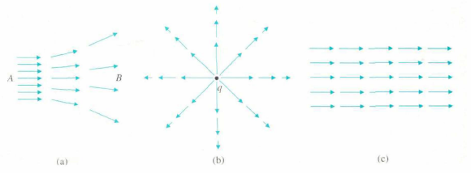
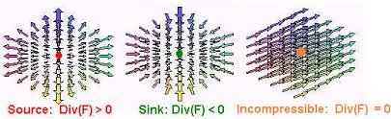
The figure shows directed flux lines
In Fig(a), the field in region A is stronger than in region B because of higher density of equal-length directed lines in A
In Fig (b), decreasing arrow length away from point q indicates decreasing stronger radial field closest to q
A net positive divergence represents the presence of a source and a net negative divergence indicates the presence of a sink
In Fig (c) there is an equal amount of inward and outward flux going through any closed volume containing no source or sink. Therefore resulting in No or Zero divergence
Flux lines of a vector field

Slide 33
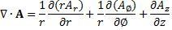
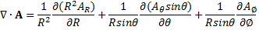
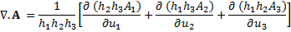
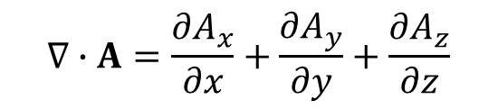
$$∇∙A=\frac{∂A_{x}}{∂x}+\frac{∂A_{y}}{∂y}+\frac{∂A_{z}}{∂z}$$
(Cartesian)
(Cylindrical)
(Spherical)
(General)

Slide 34
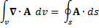
Divergence Theorem
Divergence of a vector field has been defined as the net outward flux per unit volume
Thus the volume integral of the divergence of the vector field equals the total outward flux of the vector through the surface that bounds the volume. This is known as the divergence theorem
This theory applies to any volume V that is bounded by surface S
The direction of ds is always that of the outward normal, perpendicular to the surface ds and directed away from the volume
Divergence theorem is very important in vector analysis since it converts a volume integral of vector divergence to a closed surface integral of the vector and vice versa
They are usually double and triple integrals but a single integral is used for simplicity
Divergence definition
Divergence theorem

Slide 35
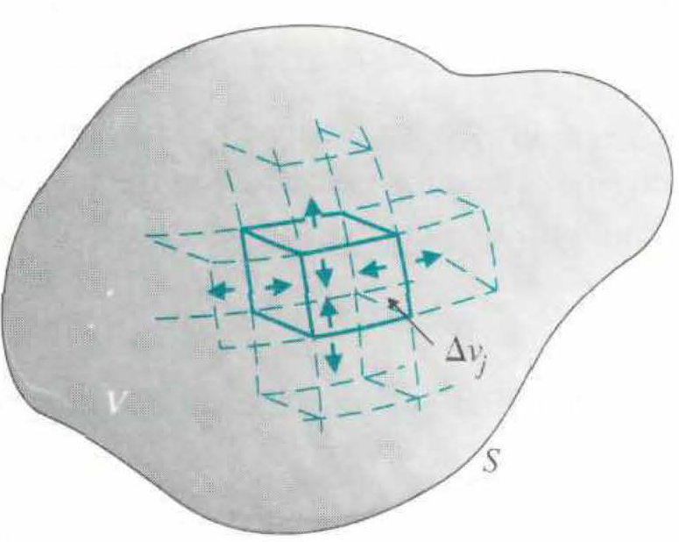
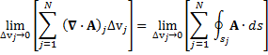
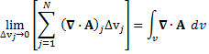
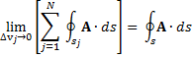
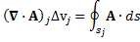
Proof of divergence theorem
The individual contributions of the differential volumes can be combined as
The left side of the equation is simplified as
A volume V can be divided in several differential volumes ∆Vj as shown above
The right side of the equation is simplified as since net contribution is due only to that of the external surface S
For a very small differential volume ∆Vj bounded by a surface sj, the definition of divergence is given by
The divergence theorem is therefore given as
Notes:
Perform calculations here

Slide 36
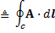
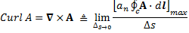
Curl of a Vector Field
Circulation of A around contour C
The net outward flux of a vector through a surface bounding a volume indicates the presence of a source
This is known as flow source. Another kind of source is called a vortex source
A vortex source causes circulation of a vector field around it
The circulation of a vector field around a closed path as defined as scalar integral of a vector over a closed path as shown
The physical meaning of circulation depends on what kind of vector A represents
Physical meaning of circulation
If A is a force acting on an object, its circulation will be the work done by the force in moving the object around the contour
If A represents an electric field intensity, E, the circulation will be an electromotive force around the closed path
Water whirling down a sink drain is an example of a vortex sink causing circulation of fluid velocity
Mathematical definition of curl of a vector A

Slide 37
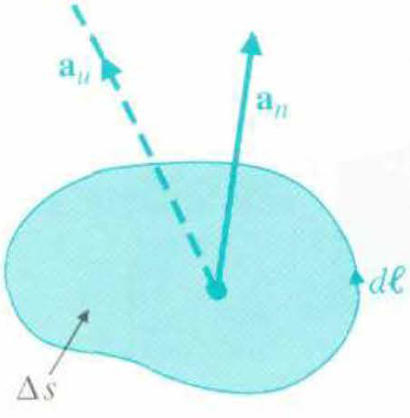
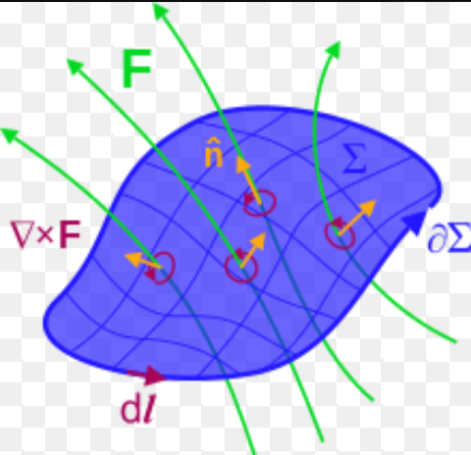
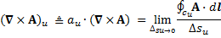
In other words, the curl of a vector A, is a vector whose magnitude is the maximum net circulation of A per unit area as the area tends to zero, and whose direction is the normal direction of the area when the area is oriented to make the net circulation maximum
Curl A is a vector point function
Normal to an area can point in two opposite directions
Using the right-hand rule such that the fingers follow the direction of dƖ and thumb points to the an direction. This is illustrated above
The component of curl A in any other direction aside the normal is given by curl of A dot the unit vector in that direction. This is illustrated above
Relation between an and dƖ in defining curl

Slide 38
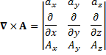
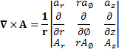
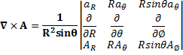
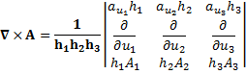
(Cartesian)
(Cylindrical)
(Spherical)
(General)

Slide 39
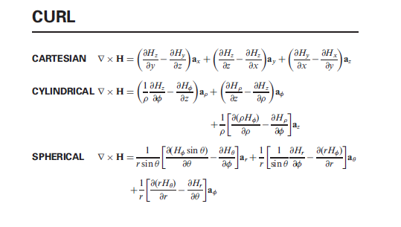

Slide 40
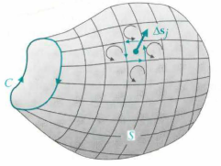





Stokes’ Theorem
For a given surface S, it can be subdivided into N small differential areas as seen in the figure. By adding the contributions of all the differential areas, we have
Now, since the common part of the contours of two adjacent elements are in opposite direction, the net contribution of all the interior elements to the total line integral is zero, and the only contribution is from the external contour C bounding the entire area S, therefore
Subdivided area: for proving Stokes’ theorem
For a small differential area ∆sj bounded by a contour cj, the definition of curl (shown below)
becomes
Combining the two equations gives us
This is achieved by taken the dot product of both sides of the curl equation with an ∆sj or ∆sj .

Slide 41



Two null identities
The curl of the gradient of any scalar field is identity is identically zero
A converse statement can also be made as: If a vector field is curl-free ( or irrotational), then it can be expressed as the gradient of a scalar field
The divergence of the curl of any vector field is identically zero
A converse statement can also be made as: If a vector field is divergenceless, then it is solenoidal and can be expressed as the curl of another vector field
IDENTITY II
IDENTITY I
USING STOKES’ THEOREM

Slide 42
Helmholtz’s theorem
Field Classifications
Helmholtz’s theorem states that: A vector field is determined if both its divergence and curl are specified everywhere
Helmholtz’s theorem is a basic element in the development of electromagnetism
For each EM field study (electrostatics, time varying electromagnetic fields, etc), the divergence and curl will have to be specified
A static electric field in a charged-free region
A steady magnetic field in a current—carrying conductor
A static electric field in a charged region
An electric field in a charged medium with a time-varying magnetic field
Solenoidal and irrotational
Solenoidal but not irrotational
Not solenoidal but Irrotational
Neither Solenoidal nor irrotational

Slide 43
TUTORIALS
Given a Vector A = -ax + 2ay - 2az. Find
(a) Its magnitude |A|
(b) The expression of the unit vector aA in the direction of A
(c) The angle that A makes with the z-axis
Given A = 5ax – 2ay + az, and B = -3ax + 4az. Find
A·B
AxB
ƟAB

Slide 44

Given a vector B = 2ax – 6ay + 3az. Find
The magnitude of B
The expression of aB
The angles that B makes with the x, y, and z axis
Assuming that a cloud of electrons confined in a region between two spheres of radii 2cm and 5cm has a charge density of:
Find the total charge contained in the region

Slide 45
Given a vector field A = r ar + z az
Find the total outward flux over a circular cylinder around the z-axis with a radius 2 and a height 4 centered at origin
Find the divergence of A ( )
Verify the divergence theorem
6. Prove the two null identities mathematically
IDENTITY I
IDENTITY II

Slide 46


3. Static Electric Fields
Static electric fields are caused by stationary electric charges
When one walks over a carpet in a dry room, the rubbing of shoes soles on the carpet produces charges on our body (e.g. fingertips)
The charges can jump across the air to a doorknob when ones touches a metal doorknob
This potential difference generated may be a several thousand volts which may cause a slight shock
Electrostatics is the study of the effects of electric charges at rest. Here the electric fields do not change with time
Electrostatics is the simplest situation in electromagnetics but it has a lot of importance, i.e. it explains phenomenon such as lightening and some industrial applications such as ink-jet printers, oscilloscopes, etc.
Augustin de Coulomb
Karl Friedrich Gauss

Slide 47




Fundamental postulates of Electrostatics in Free Space
As discussed previously, the only vector quantities considered in electrostatics is the Electric field intensity, E
Also among the universal constants, only the permittivity of free space ɛ0, is considered
Electric field intensity, E is defined as the force per unit charge that a very small stationary test charge experiences when it is placed in a region where an electric field exists
According to Helmholtz’s theorem, we have to specify the divergence and curl of E in electrostatics
The 2 postulates are simple n concise and can be used to derive any laws in electrostatics
They can be written in differential form or integral form
Fundamental postulates of electrostatics in free space (differential form)
Fundamental postulates of electrostatics in free space (integral form)
Notes:
Prove this in class…and explain the theories

Slide 48






Coulomb’s Law
Electric field intensity of a point charge at an arbitrary location
When a point charge q2 is placed in the field of another point charge q1, a force F12 is experienced by q2 due to the electric field intensity E12 of q1 at q2. This force is given as:
Point charge at the origin
Point charge NOT at the origin
Fig.1 Electric field intensity due to a point charge
This is the Coulomb’s law which states that: the force between two point charges is proportional to the product of the charges and inversely proportional to the square of the distance of separation
Electric field intensity of a point charge at the origin

Slide 49





Electric field due to a continuous distribution of charge
Electric field intensity of a volume distribution of charge
Electric field intensity of a surface distribution of charge
Electric field caused by a continuous distribution of charge can be obtained by integrating the contribution of an element charge over the charge distribution
Electric field intensity of a line distribution of charge
Electric field intensity due to an infinite straight line charge of uniform density

Slide 50





Electric Potential
Electric potential V can be defined as
Electric potential is related to the work done in carrying a charge from one point to another. Therefore in moving a unit charge from point P1 to point P2 in a electric field, work must be done against the field and its equal to:
The electric potential V of a point at a distance R from a point charge q referred at infinity is given by
Therefore the work done in moving a unit charge from P1 to P2 is equal to the Electrostatic potential difference between P1 and P2

Slide 51


Material Media in Static electric field
In previous slide, the electric field of stationary charge distribution has been discussed in Free space. Here, we’ll look at static field behavior in a material medium
The 3 main types of materials are conductors, semi-conductors and insulators (dielectrics)
INSIDE A CONDUCTOR
Inside a conductor, both free charge and electric field intensity vanish under static conditions
The tangential components of the electric field intensity E at the surface of the conductor is should be zero as well. Here, the E-field on a conductor is the normal components
Boundary conditions at a conductor-Free Space interface

Slide 52

Dielectrics in Static Electric Field
To analyze the effect of the induced dipoles, we define the Polarization Vector, P, which is the volume density of the electric dipole moment
Usually dielectrics have neutral macroscopic molecules
But the presence of an external electric field can cause a force to be exerted on each charge particle and results in the small movements of positive and negative charges in opposite directions
This creates electric dipoles and therefore causes the dielectric material to have polarity
This induced electric dipoles will modify the electric field both inside and outside the dielectric material
With the applied electric field on a dielectric, the dipoles tend to align in a manner shown above. Otherwise, they are random
Cross section of Polarized dielectric medium
Equivalent polarization surface charge density
Equivalent polarization volume charge density
Notes:
Dipole moment. Direction toward positive charge

Slide 53


The electric field intensity E gives rise to a volume charge density in free space. Now a given source in a dielectric will also produce a polarization volume charge density. Therefore the electric field intensity E, for a given source distribution (free charges) in a dielectric will be
Gauss Law states that the total outward flux over any closed surface is equal to the total free charge enclosed in that surface
IS GAUSS LAW APPLICABLE TO FREE SPACE OR DIELECTRIC MEDIUM, or both ??
When the dielectric properties of the medium are linear and isotropic, the polarization, P is directly proportional to the electric field intensity, E, as shown
D is the electric flux density or electric displacement
GAUSS LAW
Where ɛr is known as relative permittivity or dielectric constant of the medium and Xe is called electric susceptibility
Notes:
Read more on dielectric strength !!

Slide 54

Boundary Conditions for Electrostatic Fields
Electromagnetic problems usually involve different media
Therefore knowledge of field relations are the media interfaces in important
For example, how does E and D change after leaving water into air and vice versa?
We know boundary conditions of a conductor-free space
Lets consider two general media
Interface between two media
BOUNDARY CONDITIONS FOR ELECTROSTATIC FIELDS
Notes:
LOOK FOR A PIC

Slide 55

State and explain the boundary conditions that must be satisfied by the electric potential at an interface between perfect dielectric constants er1 and er2
Find Ei,Di,Pi,Eo,Do from the fig. below

Slide 56


Capacitance
It is clear that a conductor in a static field is equipotential
Suppose the potential, V, is increasing due to increase in Q
Increase in Q will in turn increase the surface charge density everywhere by the same factor without affecting the charge distribution
Therefore we can say that the potential of an isolated conductor is directly proportional to the total charge on it
The constant of proportionality C is called the capacitance of the isolated conductor, in Coulomb/Volt or Farad
Capacitance of a parallel-plate capacitor
Capacitance of cylindrical capacitor
Notes:
GET PIC OF PARALLEL PLATE CAPACITOR

Slide 57
Assume the earth to be a large conducting sphere (radius = 6370 km) surrounded by air. Find its capacitance referring to infinity
Read on Electrostatic Energy. Page 120 – 125 in the Course Book (David K. Cheng)

Slide 58

Poisson’s and Laplace Equations
$$∇∙E= \frac{ρ_{v}}{ε_{0}}$$
$$E=−∇V$$
$$∇∙∇V= ∇^{2}V= −\frac{ρ_{v}}{ε_{0}}$$
$$∇^{2}V= −\frac{ρ_{v}}{ε_{0}}$$
Poisson’s Equation
$$∇^{2} \left(del square\right)is the Laplacian operator,$$
$$whichs stands for "divergence of the gradient "$$
$$\frac{∂^{2}V}{{∂x}^{2}}+\frac{∂^{2}V}{{∂y}^{2}}+\frac{∂^{2}V}{{∂z}^{2}}= −\frac{ρ_{v}}{ε_{0}} (V/{m^{2})}$$
Poisson’s equation in Cartesian Coordinates
At a point in a medium where there is no free charge, the Poisson equations reduces to
$$∇^{2}V =0$$
Laplace’s equation
Techniques of determining electric field intensity E, electric potential V, electric flux density D for a given charge distribution is now known
In this section, we’ll discuss certain methods of solving electrostatic boundary problems when the exact charge distribution isn’t known everywhere
Here, we use Laplace and Poisson equations
Simply put, Laplace equation are used when there are no electrical charges and Poisson is used when electrical charges exist

Slide 59
The radius of the inner conductor of a long coaxial cable is a. The inner radius of the outer conductor is b. If the inner and outer conductors are kept at potentials V0 and 0 respectively, determine the electric potential, V, and Electric Field Intensity, E in the insulating material by solving Laplace’s equation

Slide 60
4. Steady Electric Currents
We have considered static electric fields in Section 3 and the boundary conditions associated with static electric fields
We’ll now consider charges in motion. These charges constitute current flow
2 main types of currents: Conduction current and Convection current
Conduction current: Drift motion of electrons in conductors and semiconductors. Their Average drift velocities are low, (about 0.001 m/s)
Convection current: Motion of electrons or ions in a vacuum or in rarefied gas

Slide 61


Current density and Ohm’s Law: convection current
Consider a steady motion of one kind of charge carriers, each of charges q over a differential surface ΔS, with velocity U. Then the total amount of charges ΔQ passing this surface in a time interval Δt is:
$$\left.∆Q=Nqu∙a_{n}∆s∆t (C\right)$$

Slide 62


Current density and Ohm’s Law: conduction current
For a current density of 7 (A/$mm^{2}$) in Copper with conductivity 5.8x${10}^{−7}$S/m. Find the Electric Intensity and the Electron drift velocity
Ans. E = 0.121 V/m, u = 0.0000347 m/s
Notes:
Ohm Law in Point form, why Point compared to V=IR??

Slide 63


Resistance and Conductance
Resistance of a straight homogeneous material of uniform cross section
Conductance
$$G= \frac{1}{R}= δ\frac{S}{l} \left(S\right) or (Ω^{−1})$$
Notes:
Find relation between resistance and resistivity

Slide 64
Three resistors having resistances 1 MΩ, 2 MΩ, and 4 MΩ are connected in parallel. Calculate the overall conductance and resistance
Ans. (1) 1.75 µOhm, (2) 1.28 mm
Determine the dc-resistance of a 1km copper wire having a 1mm radius
If an aluminium wire of the same length having the same resistance is used. What is the radius of the wire
Ans. (1) 5.49 Ohm, (2) 1.28 mm

Slide 65








Analytically Explain the following equations related to Steady Currents
$∇∙J = −\frac{∂ρ_{v}}{∂t} (A/{m^{3}})$
$∇∙J=0$
.
$$Continuity Equation$$
Differential Form
Integral Form
$$\oint_{S}{J.ds}=0$$
$$∇∙J=0$$
$$∇ ×\left(\frac{J}{σ}\right)=0$$
$$\oint_{S}{\frac{1}{σ }J.dl}=0$$
$$\sum_{j}{\left.I_{j}=0 (A\right)}$$
Boundary Conditions
$$J_{1n}=J_{2n }{ (A}/{m^{2})}$$
$$\frac{J_{1t}}{J_{2t }}=\frac{σ_{1}}{σ_{2}}$$
Notes:
Write the Joules’ Law

Slide 66

Two blocks of conducting material are in contact at the z=0 plane. At a point P in the interface, the current density is $J_{1}= 10\left(3a_{y}+4a_{z}\right)A/{m^{2}}$in medium 1 of conductivity σ1. Determine $J_{2}$ in medium 2 if σ2 = 2σ1
Ans. ${ J}_{2} =20\left(3a_{y}+4a_{z}\right) A/{m^{2}}$

Slide 67


5. Static Magnetic Fields
We have discussed static fields where we discussed the vectors D and E, where D = ɛE in a linear isotropic medium
In this section, we’ll proceed to discuss magnetism and introduce the vector quantities B and H
Words like magnet, magnetism, magnetization come from the ancient city called Magnesia where the phenomenon of magnetism was discovered
A magnetic field can be caused by a moving charge, or by current flow or by a permanent magnet
Permanent magnet
Current-carrying conductor

Slide 68




Electric intensity, E, is defined as the force on a stationary charge
$$\left.F_{e}=qE (N\right)$$
When the test charge is moving in a magnetic field, with magnetic flux density B, it experiences the same force given as shown. Where u is the velocity of the moving charge in meters/second
$$\left.F_{m}=qu × B (N\right)$$
Then the total electromagnetic force (Fe + Fq) on a charge q is given as shown. B is measured in webers per sq. meter (${Wb/m}^{2}$)
$$\left.F=q\left(E+u × B\right) (N\right)$$
Lorentz’s Force equation
Charges in motion produce a current. The current in turn, creates a magnetic field. If the current is steady, they are accompanied by static magnetic fields
Therefore to understand the vector B, like Helmholtz’s theory stated, we have to identify the divergence and curl of the B
Notes:
Tesla, Wb/sq. meter, where Wb is volt-second

Slide 69





Fundamental Postulates of Magnetostatics in Non-magnetic media (e.g. FREE SPACE)
$$\oint_{S}{B∙ds=0}$$
$$∇∙B=0$$
$$∇×B=μ_{0}J$$
$$\oint_{C}{B∙dl=μ_{0}I}$$
Differential form
Integral form
The divergence of the magnetic flux density is equal to zero (or vanishes)
The curl of the static magnetic flux density in a non-magnetic medium is equal to the current density, J
Comparing the electrostatic divergence equation to the magnetostatic divergence equation, we can conclude that THERE ARE NO MAGNETIC FLOW SOURCES
$\oint_{S}{B∙ds=0}$ is also referred to as the law of conservation of magnetic flux, which is: The total outward magnetic flux through any closed surface is zero

Slide 70


The magnetic field
Permanent magnets, like bar magnets, are usually designated into North and South poles
However, an isolated north pole or an isolated south pole cannot exist
For example, no matter how small a bar magnet is divided, there’ll always be a north pole and a south pole
This means, unlike electric charges, magnetic charges do not exist. It always exist in dipoles
This will be further explained by Gauss’ Law for magnetism (Maxwell’s equations)
Successive division of a bar magnet
Attraction and repulsion of a magnet

Slide 71










Vector Magnetic Potential
Static E-field potential
$$V= \frac{1}{4πε_{0}}\int_{v^{′}}{\frac{ρ_{v}}{R}}dv^{′}$$
$$V= \frac{μ_{0}}{4π}\int_{v^{′}}{\frac{J}{R}}dv^{′} {(Wb}/m)$$
$$J dv^{′}=JS dl^{′}=I dl^{′}$$
$$V= \frac{μ_{0}I}{4π}\oint_{C^{′}}{\frac{dl^{′}}{R} } {(Wb}/m)$$
The vector magnetic potential is given by
$$B=∇ × V Tesla (T)$$
To understand the magnetic potential V, we can have to define its divergence and curl according to Helmholtz
Finding the vector magnetic potential from current density
$$∇ ×B= ∇ × ∇ × V=μ_{0}J$$
$$∇ × ∇ × V= ∇ \left(∇∙V\right)− ∇^{2} V$$
$$∇^{2} V= ∇ \left(∇∙V\right)− ∇ × ∇ × V$$
Finding the vector magnetic potential from current in a closed circuit
$$μ_{0}J$$
$$∇ \left(∇∙V\right)− ∇^{2} V=μ_{0}J$$
$$B= \frac{μ_{0}I}{4π}\oint_{C^{′}}{\frac{dl^{′}×a_{R}}{R^{2}} } (T)$$
Using the Coulomb’s conditions:
$$∇∙V=0$$
Biot-Savart Law
For finding Magnetic flux density from Current in a closed circuit
$$∇^{2} V={− μ}_{0}J$$
Vector Poisson’s equation

Slide 72



Just like with static E fields, a magnetic material under the influence of a magnetic field will be affected
Atoms have nucleus and orbiting electrons.
The orbiting electrons produces currents and cause magnetic dipoles
In the absence of an external electric field, the magnetic dipoles have random orientation and no net magnet dipole moment. The applications of an external magnetic field introduces dipole moments due to the movement and spinning of the electrons
The magnetic material becomes polarized and introduces a magnetization vector, M
IF M is uniform inside a material, the currents in the dipoles will flow in opposite direction and cancel each other, leaving Jmv = 0, otherwise it is non-zero
$$\left.J_{ms}=M × a_{n} (A/m\right)$$
Magnetization surface current density
$$\left.J_{mv}= ∇ × M (A/{m^{2}}\right)$$
Magnetization volume current density
$$\left.∇ × B= μ_{0}(J+ J_{mv}\right)$$
Curl of magnetic flux density in the presence of a magnetized material

Slide 73











Magnetic field Intensity, H, and relative permeability, µ
When the magnetic medium is linear and isotropic, the magnetization is proportional to the magnetic field intensity
$$\left.∇ × B= μ_{0}(J+ J_{mv}\right)$$
$$\frac{1}{μ_{0}}∇ × B=J+J_{mv}=J+ ∇ × M$$
$$M= χ_{m}H$$
$$∇ × \left(\frac{B}{μ_{0}}−M\right)=J$$
$$B=μ_{0}\left(1+χ_{m}\right)H$$
$${= μ}_{0}μ_{r}H$$
$$B=μH \left({Wb}/{m^{2}}\right)$$
$$H= \left(\frac{B}{μ_{0}}−M\right) {\left(A\right.}/{\left.m\right)}$$
$$∇ × H=J {\left(A\right.}/{\left.m^{2}\right)}$$
$$\int_{s}{(∇ × H)}∙ds=\int_{s}{J}∙ds$$
$$B_{1n}= B_{2n} ({μ_{1}H}_{1n}= {μ_{2}H}_{2n})$$
Using Stokes theorem
$$H_{1t} = H_{2t}$$
$$\oint_{c}{ H∙dl=I} \left(A\right)$$
Ampere’s circuital law for steady currents
Boundary Conditions
Magnetostatic Fields
Notes:
Problem with boundary condition ?? Flux Linkage ?? Mutual flux ??

Slide 74
Static Electric Fields vs Static Magnetic Fields
PREPARE NOTES ON THIS PAPER FOR CLASS

Slide 75
6. Time-Varying Fields and Maxwell’s Equations
Static models are simple but inadequate for explaining time-varying electromagnetic phenomena
Static fields do not give rise to waves that propagates and carry energy
Waves are the outcomes of EM action at a distance
In time-varying fields, a model that relates the field vectors E and D, with B and H will be created
In time-varying fields, the two divergence equations for static electric fields and static magnetic will be used, and their two curl equations will be modified so it is consistent with the law of conservation of charge
The two modified curl equations and the two divergence equations are known as Maxwell’s equations, which constitute the foundation of electromagnetics
Notes:
In what medium can both static electric and magnetic fields exist (electromagnetostatic field) ? Why don’t they give rise to waves ?

Slide 76





FARADAY’S LAW
$$EMF=−\frac{dɸ}{dt} \left(V\right)$$
Faraday’s Experimental setup
$$∇ × E=−\frac{∂B}{∂t}$$
FARADAY’S LAW
Interpretation of Faraday’s law ??

Slide 77




AMPERE’S LAW
Ampere’s Law relates the net magnetic field along a closed loop to the electric current flowing through the loop
$$∇ × H= J+\frac{∂D}{∂t}$$
Interpretation of Ampere’s law ??

Slide 78












Maxwell’s equations
James Clerk Maxwell’s [1837 – 1879] took a set of known experimental laws and unified them into a coherent set of equations known as Maxwell’s equations
Maxwell was one of the first to determine the speed of an EM wave was the same as the speed of light – and conclude that EM waves and visible light were really the same thing
$$\oint_{s}{D∙ds}= \int_{V}{ρ_{v}}dv$$
$$GAUSS^{′}LAW$$
$$∇ ∙ D=ρ_{v}$$
$$∇ ∙ B=0$$
$$\oint_{s}{B∙ds}=0$$
$$GAUSS^{′}LAW$$
$$for magnetism$$
$$∇ × E=−\frac{∂B}{∂t}$$
$$\oint_{c}{E∙dl}= \int_{s}{\frac{∂B}{∂t}}∙ds$$
$$FARADAY^{′}S LAW$$
$$∇ × H= J+\frac{∂D}{∂t}$$
$$\oint_{c}{H∙dl}= \int_{s}{\left( J+\frac{∂D}{∂t}\right)}∙ds$$
$$AMPERE′S LAW$$
Differential Form
Integral Form
Notes:
Boundary Conditions of Time varying fields ??

Slide 79

Relevance of Maxwell’s third and Fourth Equations ??
Boundary conditions of Time-Varying electric fields between two media
$$E_{1t}= E_{2t} (V/m)$$
$$B_{1n}= B_{2n} (T)$$
$$a_{n2} × (H_{1}− H_{2})= J_{s} (A/m)$$
$$D_{1n}− D_{2n}=ρ_{S} \left(C/{m^{2}}\right)$$
How do these boundary conditions change in lossless media ??
How do these boundary conditions change between a dielectric and a perfect conductor ??

